Slide 1
Titanic dataset.

Slide 2
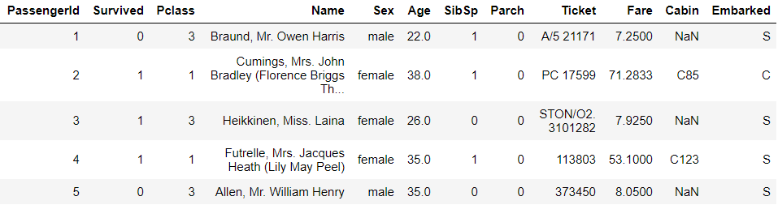
This is the sample of dataset:

Slide 3
Data understanding:
As we can see we have 12 columns which are:
PassengerId of each passenger.
People who Survived.
Pclass represents Ticket class of passengers.
Name of each passenger.
Sex of each passenger.
Age of each passenger.
SibSp represents number of siblings/spouse traveling with a passenger.
Parch represents number of parents/children traveling with a passenger.
Ticket number of passenger.
Fare of the ticket.
Cabin of the passenger.
From where the passenger was Embarked.

Slide 4
Data cleaning:
First thing I did was found out number of missing values in dataset. There were 117 in Age, 687 in Cabin and 2 in Embarked feature in train data and 86 in Age, 1 in Fare and 327 in Cabin feature in test data.
So, I filled that 1 missing value in Fare with median of Fare column.
We found that S has appeared in Embarked the most so I filled all missing values in Embarked with S.
Then I took Mean and S.D. of Age and filled all missing values with random numbers from the rage (mean-sd, mean+sd).
Created a new feature named Deck since all elements of Cabine were alphanumeric for eg. 'C85', 'C123', 'E46'. So I splitted them and kept the alphabetical values which represents Deck and removed the number part since it denoted room number on that particular deck.

Slide 5
Exploratory Data Analysis

Slide 6
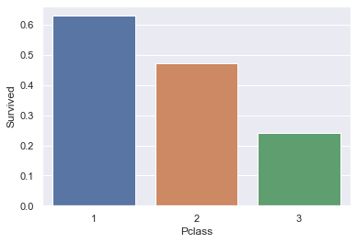
Pclass
As we can see people who travelled from 1st class had more chances of survival.
And other classes are relatively less safer.
Travelers from 3rd class had less than 30% chance of survival.

Slide 7
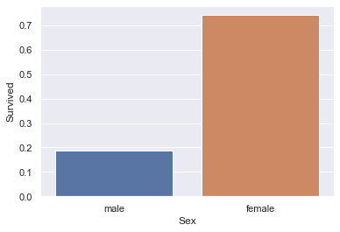
Sex
There were 577 males and 314 females in the ship.
Even though males were more in numbers than females, there were more chances of surviving if you are a female.

Slide 8
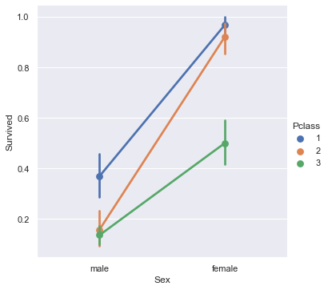
Sex vs Survived with Pclass as hue:
Females overall had more chances of survival than males.
Females who had less chances of survival were from 3rd class.
Males from 1st class had more chances of survival than other 2.

Slide 9
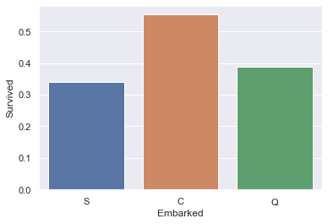
Embarked
77 people from Q(Queenstown), 168 from C(Cherbourg) and 646 from S(Southampton) were boarded.
That makes around 72% of the passengers were boarded from Southampton.
That could be the reason why most of the passengers died were boarded from S.

Slide 10
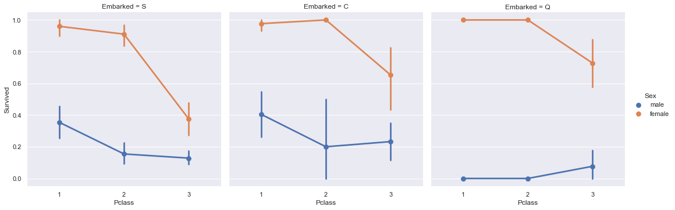
Pclass vs Survived with Sex as hue and Embarked as col:
1. Almost all the females survived who were traveling in first 2 classes, most of the female deaths happened in 3rd class.
2. Most of the men who survived were from 1st class.
3. So over all people traveling by 3rd class had less chances of survival and from where the boarded doesn't make much difference but still there is a pattern.

Slide 11
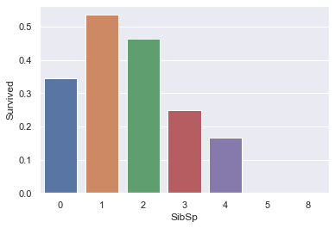
SibSp:
So if you are travelling alone or with more than 3 people you are more likely to not survive.
If you are in a group of 2 or 3, you have higher chances of survival.
Maybe the reason could be if you are alone there is no one to help you and if you are with too many people then it is hard to keep eye on everyone.
In small groups you have people to help and doesn't and you can easily watch for each other.

Slide 12
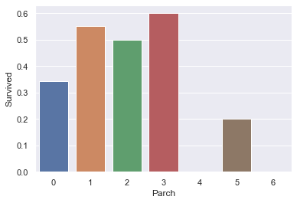
ParCh:
In SibSp and Parch both the features we can see that people who are traveling alone have less chances of survival. We will check for correlation between them afterwards.
They could be correlated since they represent family size.

Slide 13
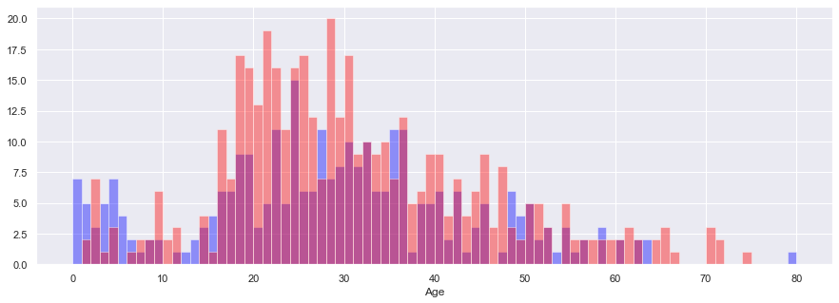
Age
Total data
1. Children till the age 16 had more chances of survival.
2. Adults from age 18-65 had less chances of survival.

Slide 14
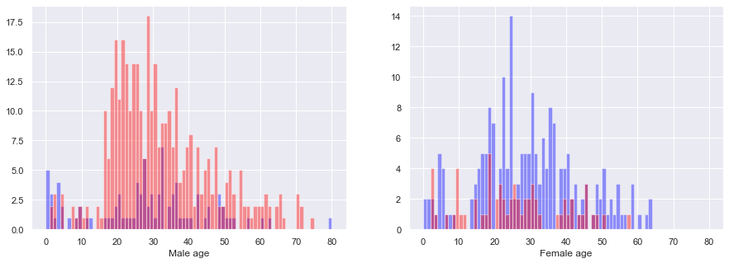
Male data
Children till the age 16 had more chances of survival.
Most of the people who died were from age group 18-75.

Slide 15
Female data
Mostly everyone survived but people from the age of 2-12, 15-34 and 38-52 had relatively less chances of survival than others.
Mostly deaths happened in adults from age 18 to 32 and and 40 to 50.

Slide 16
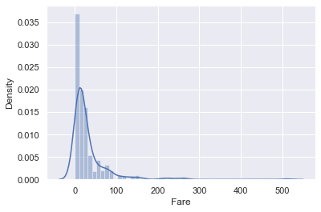
Fare distribution
Fare is not normally distributed and has a lot of outliers which represent ticket fare of higher classes. Aslo Fare is different according to someone's age and the class they are traveling in so we need to group it.

Slide 17
Summary:
Passengers who had bigger chances of survival than others had these characteristics:
Able to afford upper class ticket.
Being a female.
Travelling with a small family.
Bellow age 17.

Slide 18
Model building:
Now based on the current data we have gone through some operations to build a predictive model:
Make Input and Output variables.
Use train_test_split() to make split data into 80-20 to create train data and test data respectively.
Try multiple models and compare their MSEs & Confusion matrix.
Then compare different models with each other to see which one gives better accuracy and then that will be our final model.

Slide 19
Compared models:
Here are the results after Hyperparameter tuning:
Model name | Confusion matrix | Accuracy
Logistic regression | [[359 78] [ 84 191]] | 87.15%
Decision tree | [[375 62] [ 94 181]] | 86.03%
Random forest | [[369 68] [ 91 184]] | 87.71%
So Random forest will be the final model for this dataset.

Slide 20
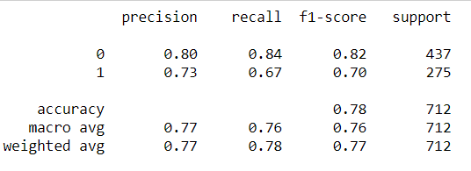
Classification report of Random forest:
Precision means out of all the predicted positives how many positives did our model predicted correctly.
Recall means out of all the actual positives how many positives did our model predicted correctly.
F1-score is a harmonic mean of precision and recall.

Slide 21
Feature values indication:
Values of features like Age and Fare are divided in groups. If your value belongs to a group you enter that groups number.
Age: 0= ‘<16.336’, 1= ‘(16.336, 32.252]’, 2= ‘(32.252, 48.168]’, 3= ‘(48.168, 64.084]’ and 4= ‘>64.084’.
Fare: 0= ‘<7.896’, 1= ‘(7.896, 14.454]’, 2= ‘(14.454, 31.472]’ and 3= ‘>31.472’.
Pclass is entered as it is.
Sex: ‘male’=1 and ‘female’=0.
Embarked: 1= ‘S’, 2= ‘C’ and 3= ‘Q’.
Deck: 'B'=1, 'E'=2, 'A'=3, 'C'=4, 'D'=5, 'F'=6, 'G'=7 and ‘Null’=0.
Titles: 'Mr'=1, 'Mrs'=2, 'Miss'=3, 'Master'=4 and 'Others'=5.
Alone: I the passenger is alone then we put 1 otherwise 0.

Slide 22
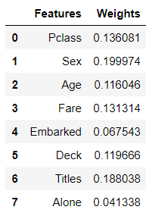
Coefficients of features according to the model:
So as shown before we enter value in model and predict if a passenger can survive or not..
And these are the respective coefficients of the features.

Slide 23
Thank you.

